Slide 1

US College Net Price Prediction using ML Regression Models
CIS 5560 - Term Project Instructor: Dr. Jongwook Woo
Group 2
Ayushi Porwal Kajal Bhandare Zalak Patel

Slide 2
Data Source URLs
GitHub URL:
Dataset URL(2.16 GB):
GitHub Dataset URL:
https://collegescorecard.ed.gov/data/
https://github.com/zalak2306/US-College-Scorecard-/blob/main/SampleData/Sample_USscorecard.csv
https://github.com/zalak2306/US_College_Net_Price_Prediction_ML_Regression_Models

Slide 3

H/W Specifications
Hadoop Version - 3.3.3
Pyspark Version - 3.2.1
CPU Speed: 2.40 GHz
# of CPU cores: 4
# of nodes: 3
Memory Size: 806.4 GB

Slide 4
Advantages of Predicting college Net Price
Informed Decisions: Know net price after aid for college affordability.
Aid Allocation: Predict net prices to distribute financial assistance effectively.
Enrollment Retention: Accurate net price prediction attracts and retains students with competitive aid packages.

Slide 5
Project Scope
Predict Net Price using various Pyspark Machine Learning Models.
Data Cleaning and Feature Engineering
Use Hyper-parameters and parameters tuning.
Use CrossValidation and TrainValidationSplit to improve model perfomance.
Comparing the difference between four Regression Models
Check model for overfitting

Slide 6
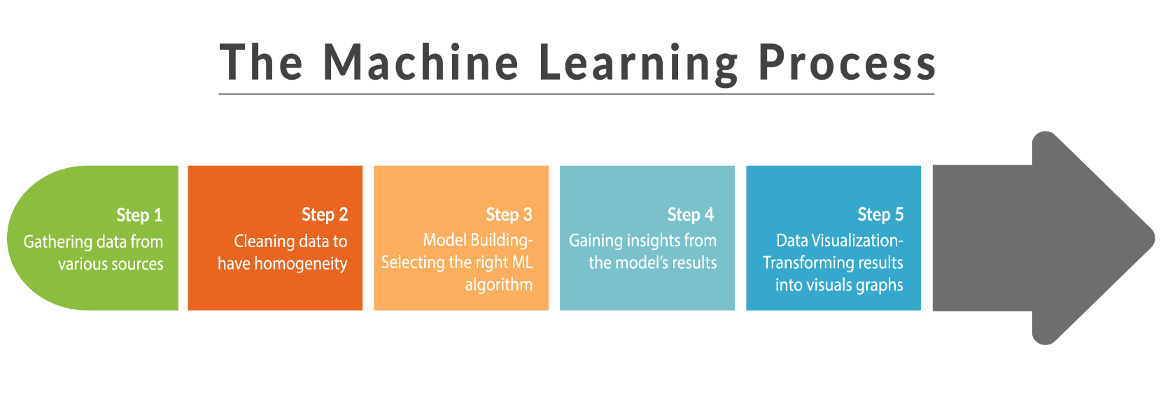

Slide 7
Flow Chart
Gathering Data
Data & Feature Engineering
Data Split
Train, Test & Validate
Evaluate

Slide 8



Architecture
Data Source
Data & Feature Engineering
Data Modelling
Data Validation
(College Scoreboard)
(Databricks, Zeppelin, Spark CLI, Removing Outliers, Indexers, Vectorassemblers, MinMax, Pipeline, Hadoop HDFS)
(Using Pyspark ML lib & tuning parameters with CrossValidation & TrainValidationSplit)
(Using Regression Evaluator)

Slide 9

Machine Learning Algorithms used
Regression:
Random Forest
Gradient Boosting Tree
Decision Tree
Linear Regression

Slide 10
Hyper Parameter & Tuning
Created a pipeline consisting of StringIndexer, VectorAssembler, MinMax Scaler to transform values.
Used ParamGridBuilder to add and tune hyper parameters such as maxIter, regParam, maxBins, maxDepth, numTrees, minInfoGain
TrainValidationSplit & CrossValidation

Slide 11
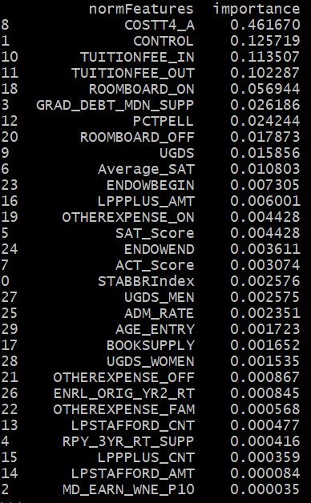
Feature Importance

Slide 12
Comparing Models Regression TVS
Model Name | RMSE | R2 | Time
Random Forest-tvs | 2724.013 | 0.8471 | 128.63 sec
GBT Regressor-tvs | 2773.352 | 0.8480 | 2167.57 sec
Decision Tree-tvs | 3414.359 | 0.7657 | 133.31 sec
Linear Regression-tvs | 3314.532 | 0.7700 | 513.58 sec

Slide 13
Comparing Models Regression - CV
Model Name | RMSE | R2 | Time
Random Forest-cv | 2744.991 | 0.8447 | 293.09 sec
GBT Regressor-cv | 2778.004 | 0.8475 | 5182.68 sec
Decision Tree-cv | 3414.359 | 0.7657 | 318.01 sec
Linear Regression-cv | 3314.532 | 0.7700 | 1458.97 sec

Slide 14
Overfitting
Verified overfitting for RF Model.
Evaluated RMSE and R2 on both Train and Test Data.
Metrix | Test Data | Train Data
RMSE | 2724.013 | 2108.680
R2 | 0.8471 | 0.9081

Slide 15
Conclusion
After comparing all the Regression models,
Random Forest with Train Validation Split is the best fit models with least Root Mean Square Error and highest R2.

Slide 16
CHALLENGES
Understanding the big dataset combined from 10+ consecutive years
Understanding the features and their meaning
Handling null values
Cleaning a large amount of data
Frequent Parameter tuning to achieve higher accuracy

Slide 17
QUESTIONS?

Slide 18
THANK
YOU

